Slide 1
Principal Component Analysis (PCA)
Edward Wang, Ph.D.

Slide 2
Why Component Analysis?
To identify underlying latent factors/hidden relationships among variable rather than the observed data
To deal with large data with may observations/variables:
To visualize
To reduce noise embedded in data
To reduce them to smaller set of components, for higher computational efficiency
To build more effective data analytics on the reduced-dimensional space

Slide 3
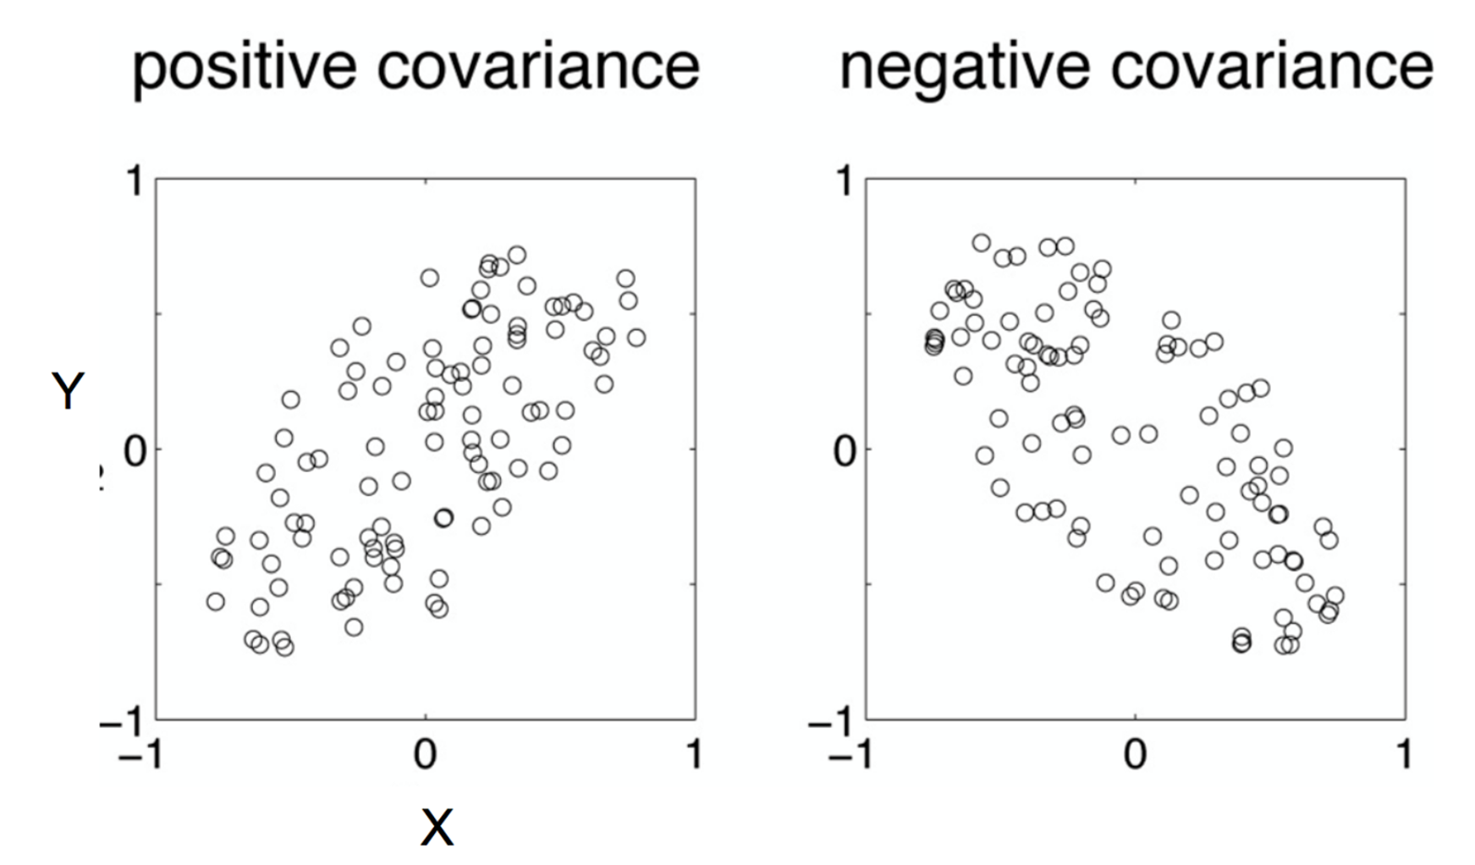
Component Analysis
If two items or dimensions are highly correlated or dependent
They are likely to represent highly related phenomena
If they tell us about the same underlying variance in the data, combining them to form a single measure is reasonable
So we want to combine related variables, and focus on uncorrelated or independent ones, especially those along which the observations have high covariance

Slide 4
Principal Component Analysis
Most common form of factor analysis
The new variables/dimensions
Are linear combinations of the original ones
Are uncorrelated with one another
Orthogonal in original dimension space
Capture as much of the original variance in the data as possible
Are called Principal Components

Slide 5
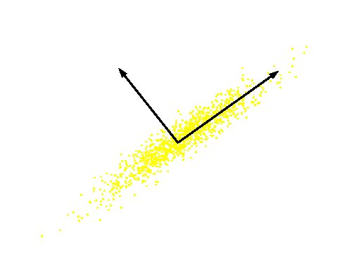
Principal Components
1st PC along with the largest covariance of the data
After removing the 1st PC from original data, 2nd pC represnets the largest covariance of the residuals
And so on
Original Variable B
PC 2
PC 1
Original Variable A

Slide 6
Finding the PCs
Data points are vectors in a multidimensional space
Projection of vector x onto an axis (dimension) u is ux
Direction of largest covariance is that in which the average square of the projection is largest, i.e. E((ux)²) = E (uxx^{T}u^{T})
The direction of u is the direction of the 1st PC
E(uxx^{T}u^{T}) is maximized by finding E(uλu^{T}), where u is the eigenvector corresponding to the largest eigenvalue
The eigenvalue denotes the amount of variability captured along that dimension

Slide 7
Why Eigenvalues
Maximise u^{T}xx^{T}u s.t u^{T}u = 1
Construct Langrangian u^{T}xx^{T}u – λu^{T}u
Vector of partial derivatives set to zero
xx^{T}u – λu = (xx^{T} – λI) u = 0
As u ≠ 0 then u must be an eigenvector of xx^{T} with eigenvalue λ

